Slide 1
Clustering of motion vectors

Slide 2
Pre-processing of motion vectors
Finding average motion vector field
Clustering of average motion vectors using dbscan
Merging similar clusters
Crowd flow segmented output
Pre-processing of mv: calculated threshold value to find dynamic region in video and created motion mask . Finding average mv field : averaged all motion vectors presented in motion mask over all frames. Clustering of average mv using dbscan : calculated correlation matrix of avrg mv and passed it to dbscan. Merging similar clusters : clusters which we got from dbscan are merged if they are similar.

Slide 3
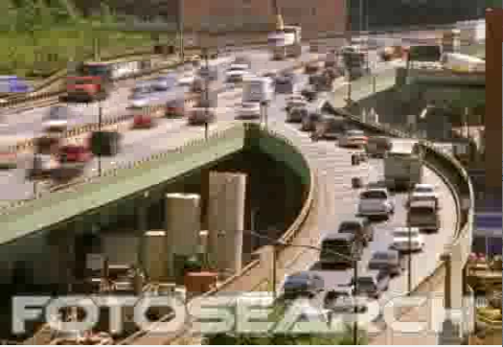

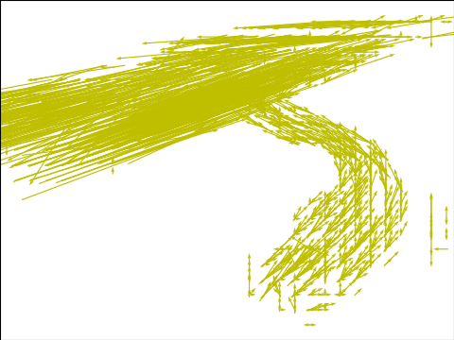
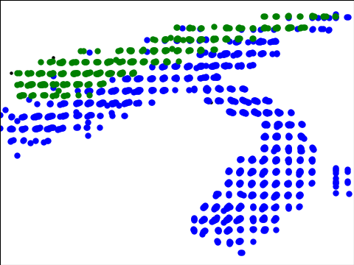
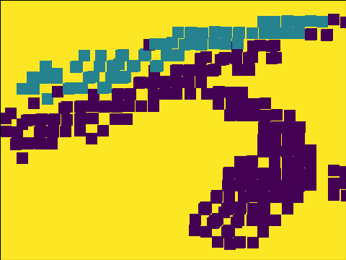
Clustering of Average motion vector fields of input video6

Slide 4
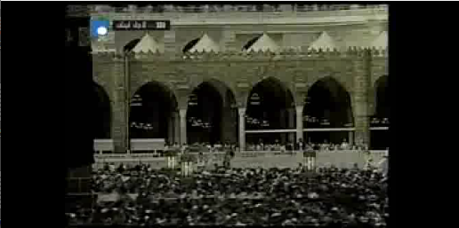

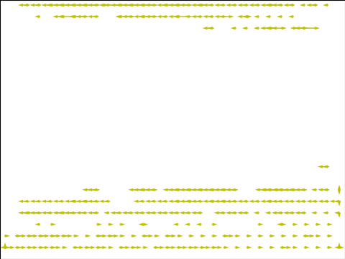
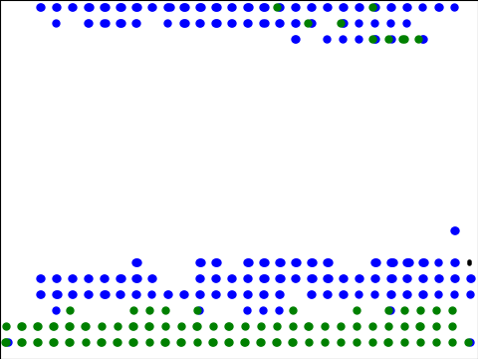
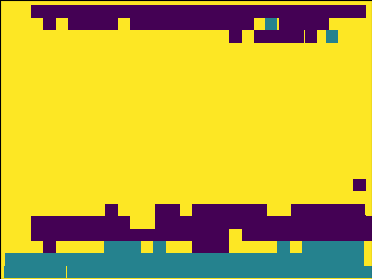
Clustering of Average motion vector fields of input video7

Slide 5
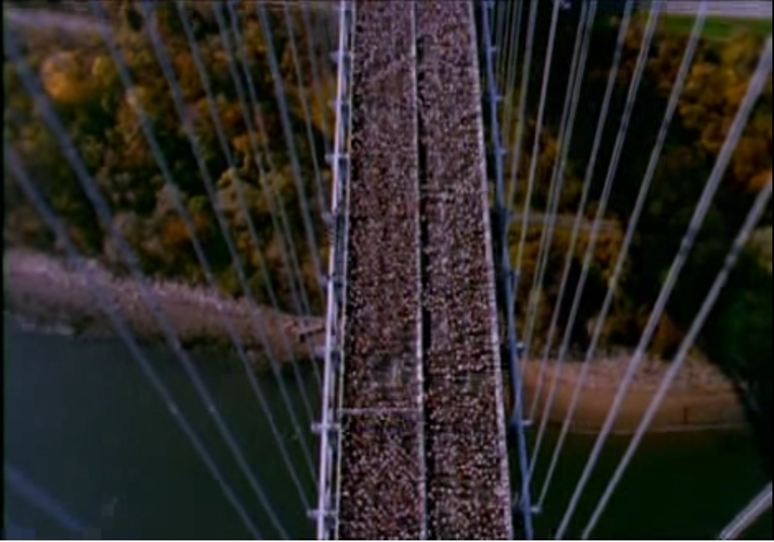

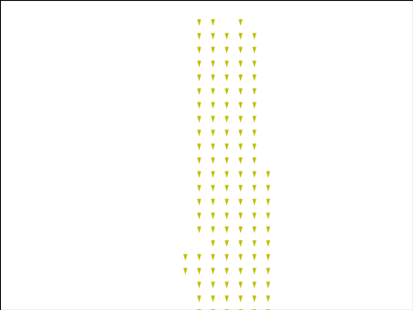
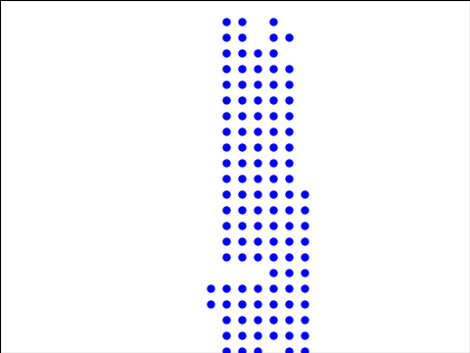
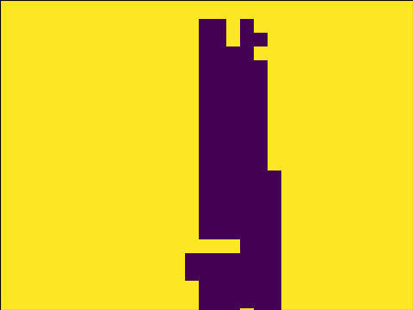
Clustering of Average motion vector fields of input video5

Slide 6
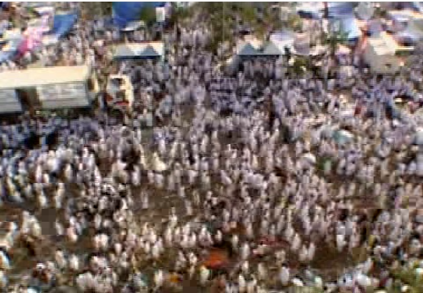

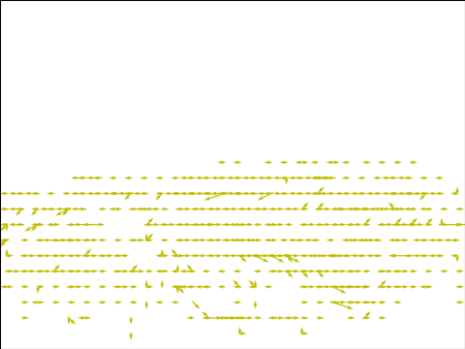
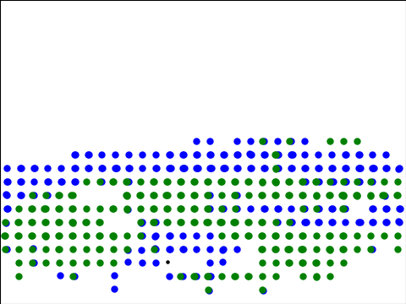

Clustering of Average motion vector fields of input video8

Slide 7
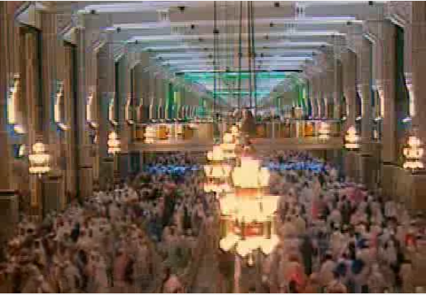


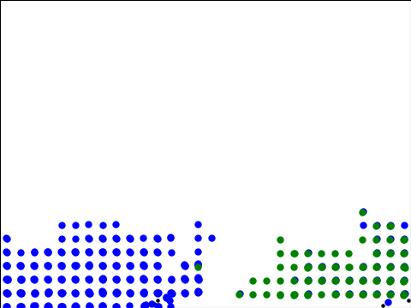

Clustering of Average motion vector fields of input video9

Slide 8
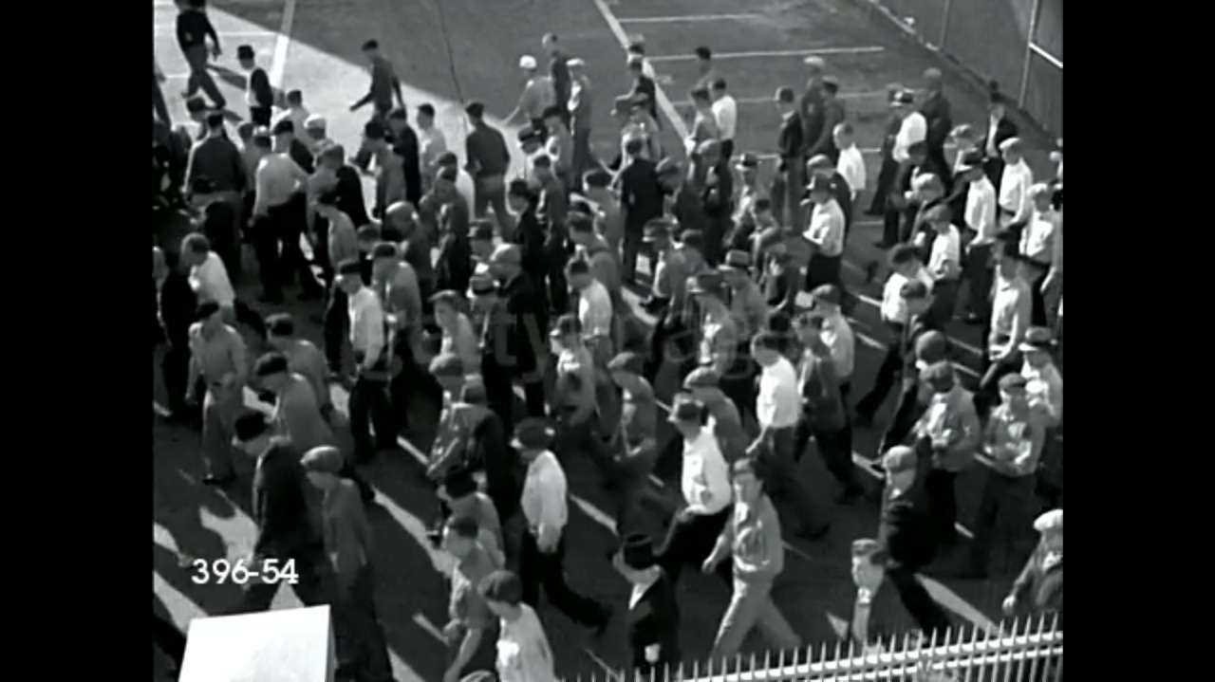
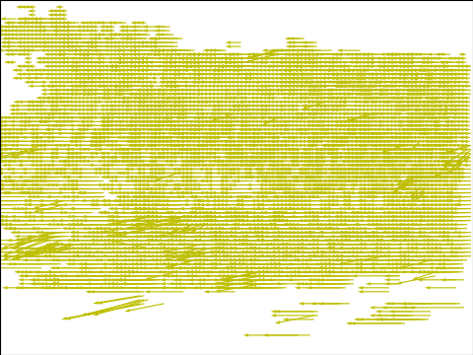
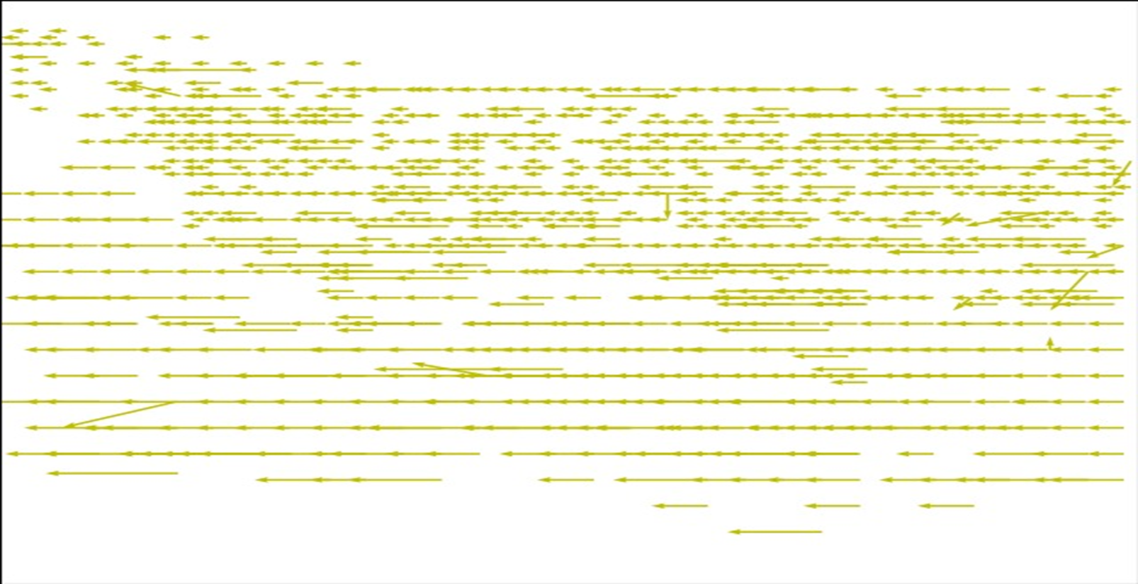

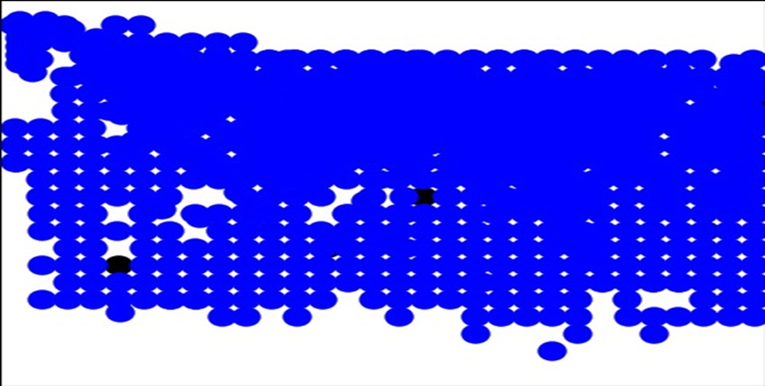
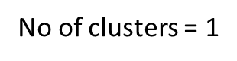
Clustering of Average motion vector fields of input video1

Slide 9
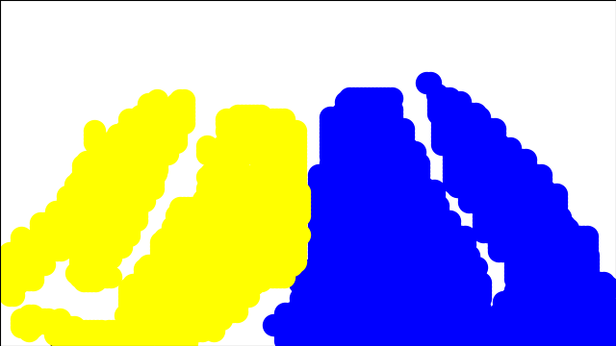
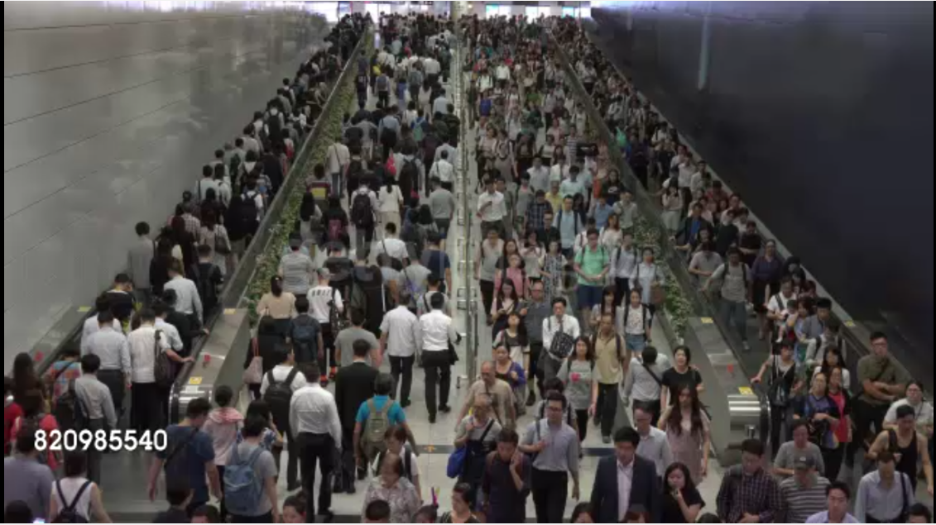
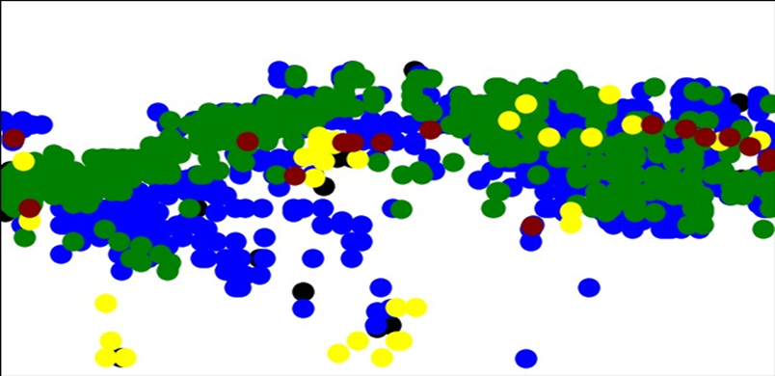
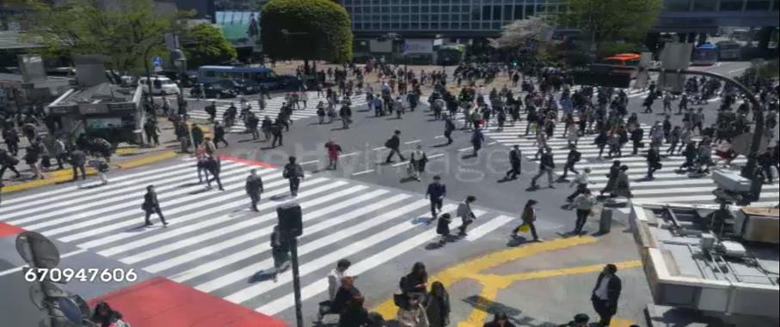
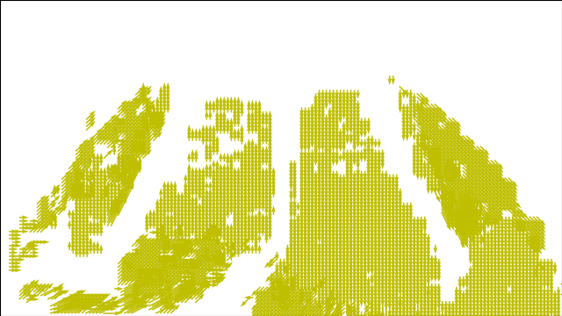
Clustering of Average motion vector fields of input video2
No of clusters = 2

Slide 10
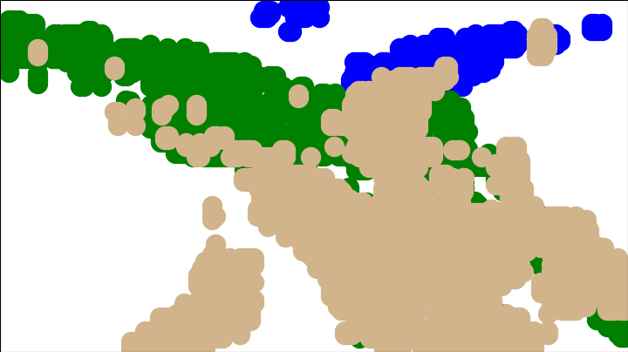
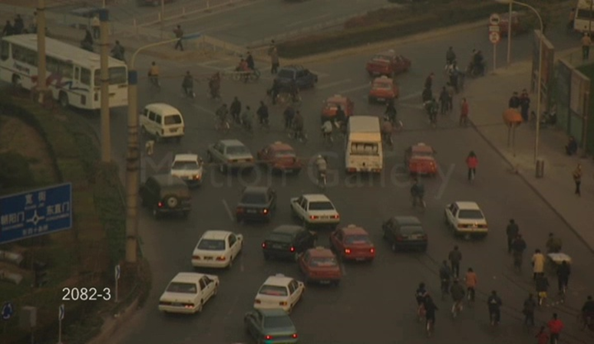
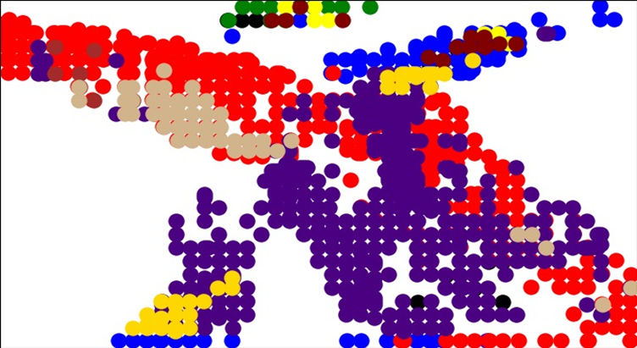
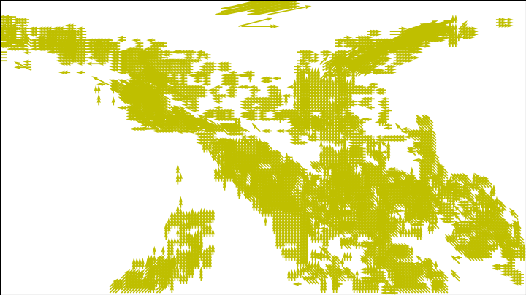
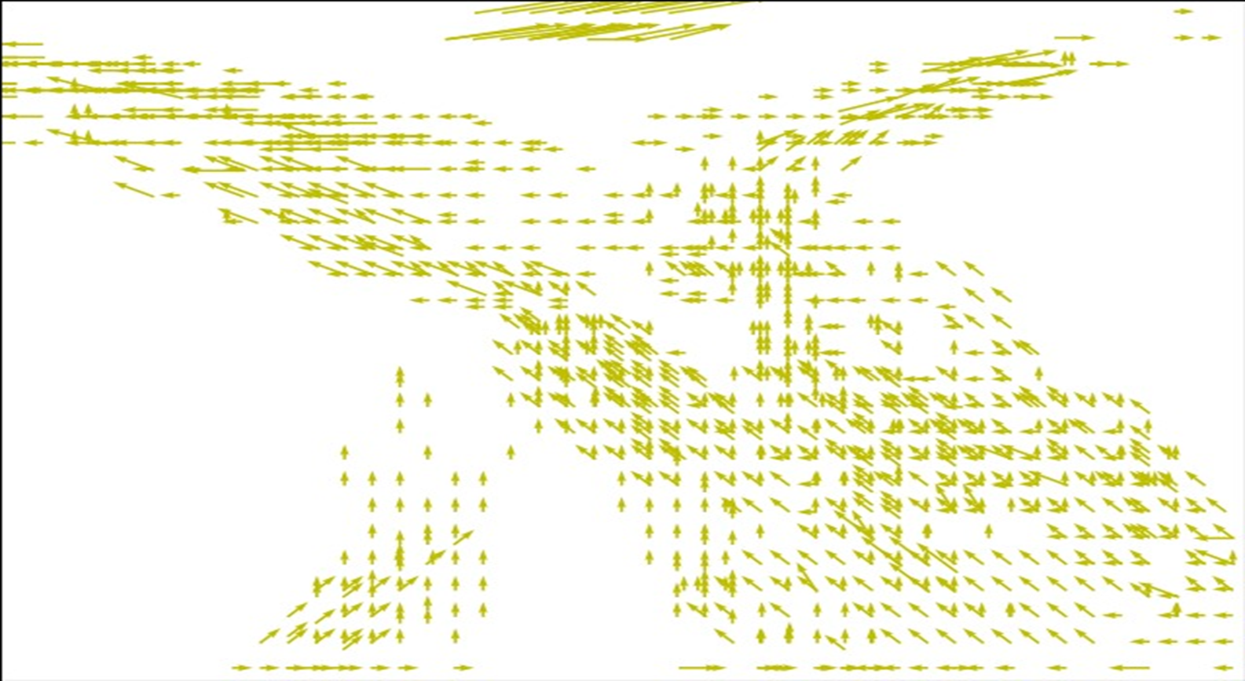
Clustering of Average motion vector fields of input video3
No of clusters = 3

Slide 11
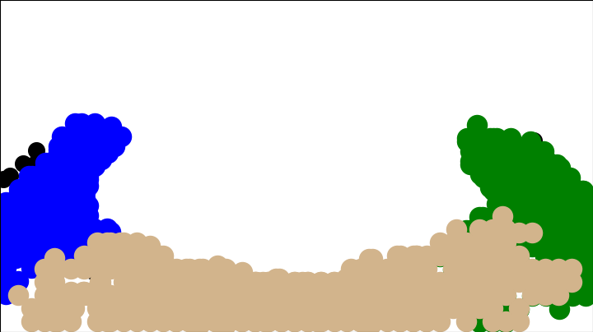
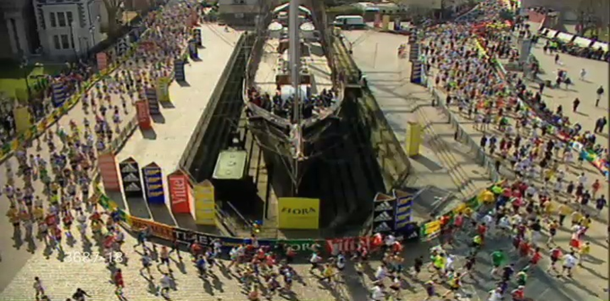
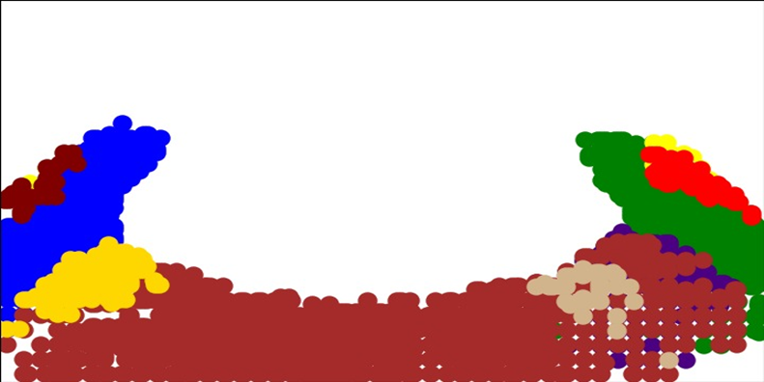
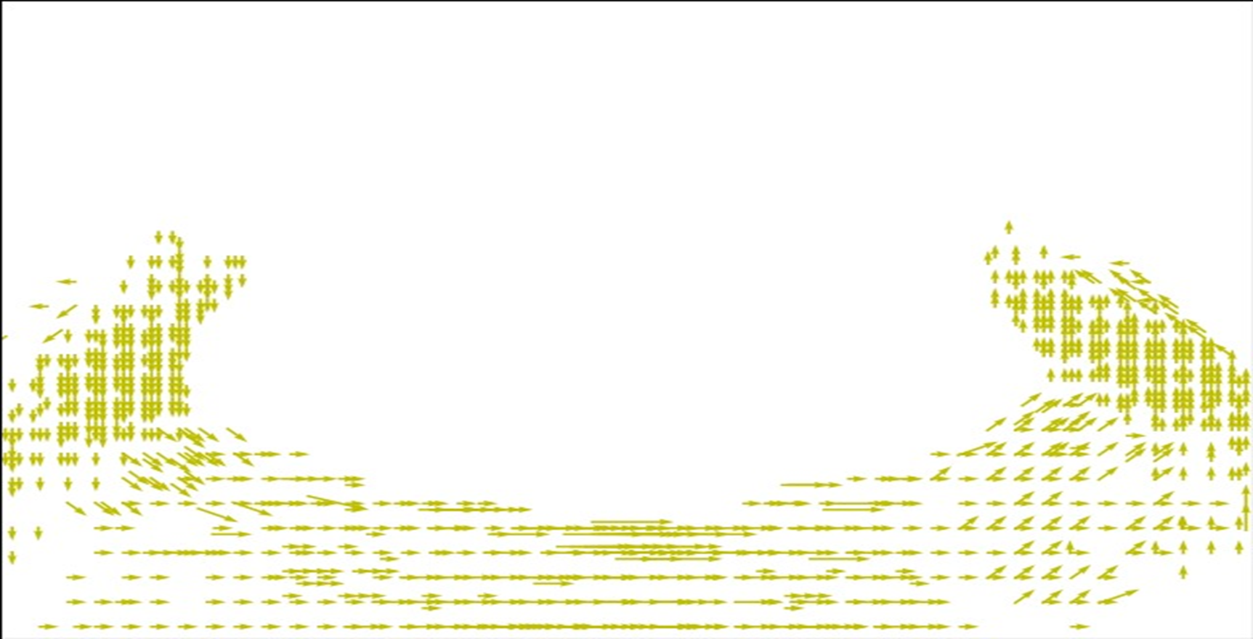
Clustering of Average motion vector fields of input video4
No of clusters = 3

Slide 12
Crowd2 video
Threshold value:23
Min frames:2
Eps:1
Min Sam:10
Crowd3 video
Threshold value:5
Min frames:3
Eps:1
Min Sam:10

Slide 13
Crowd4 video
Threshold value:14
Min frames:4
Eps:1
Min Sam:10
Crowd1 video
Threshold value:5
Min frames:6
Eps:1
Min Sam:10

Slide 14
Crowd6 video
Threshold value:4
Min frames:1
Eps:1
Min Sam:10

Slide 15
THE END

